Slide 1


E-Commerce User reviews

Slide 2


Business Use Case

Slide 3
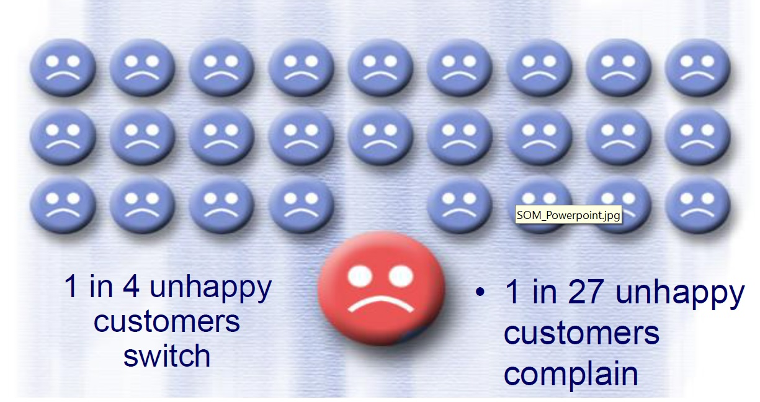
Why Customer Satisfaction

Slide 4
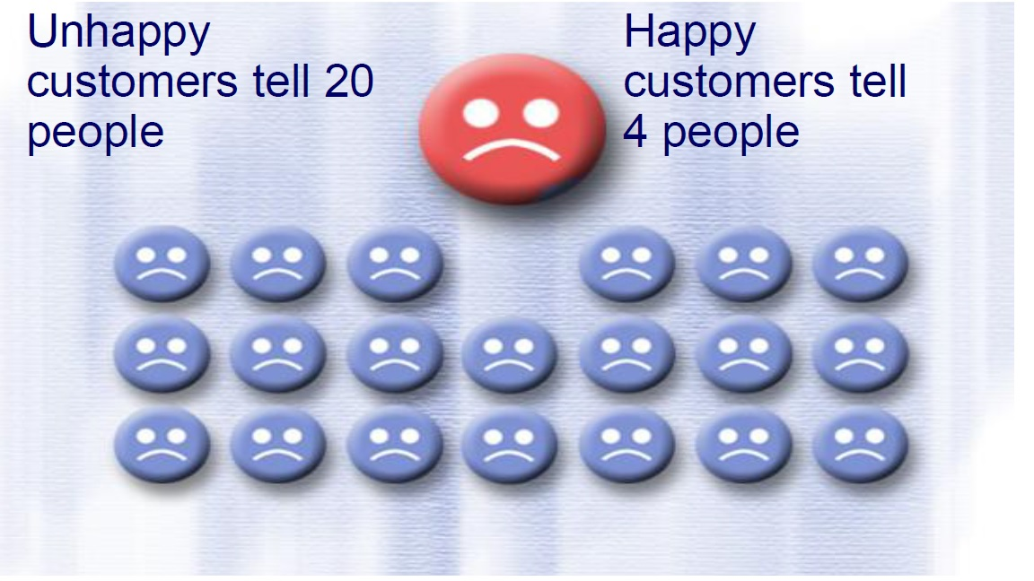
Why Customer Satisfaction

Slide 5
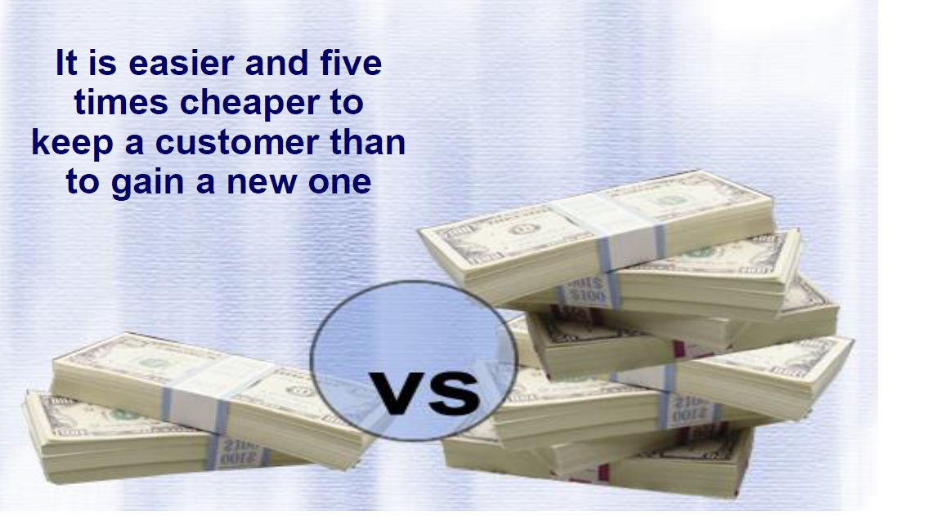
Why customer Satisfaction

Slide 6
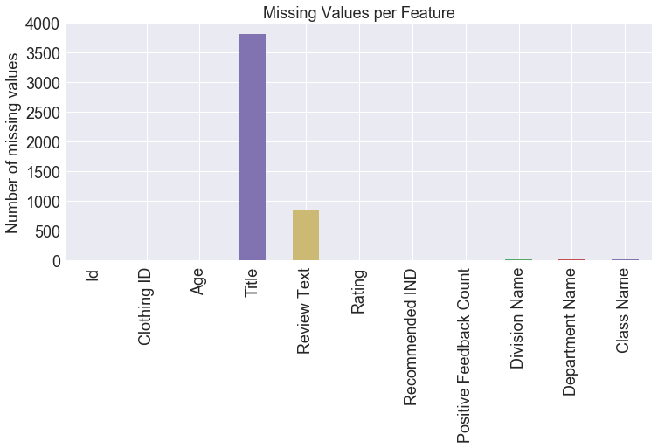
Exploratory Data Analysis

Slide 7
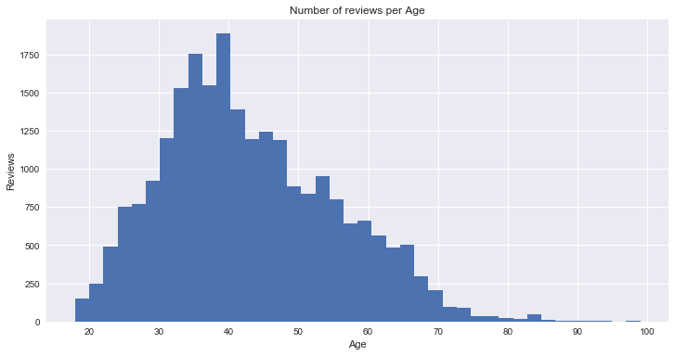
ExploratoRy Data Analysis

Slide 8
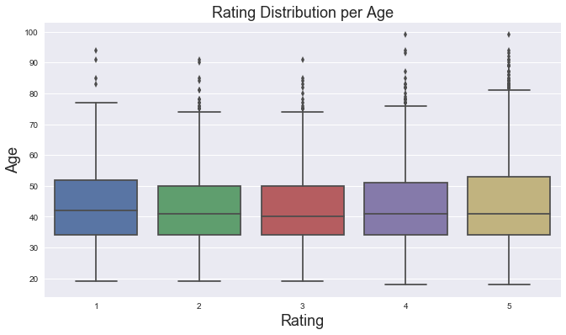
Exploratory Data ANalysis

Slide 9
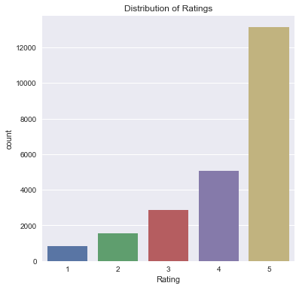
Exploratory Data ANalysis

Slide 10
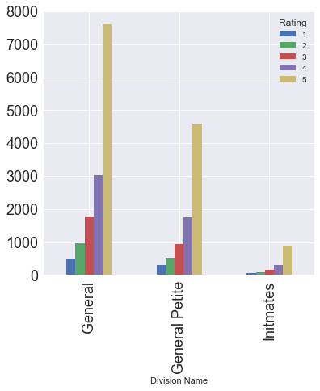
Exploratory Data Analysis

Slide 11
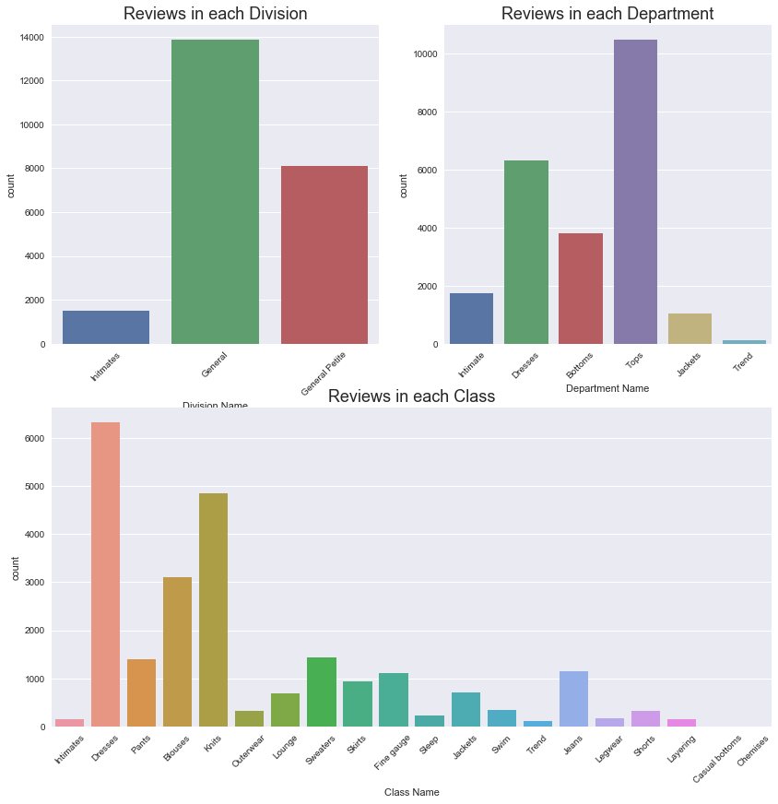
Exploratory data Analysis

Slide 12
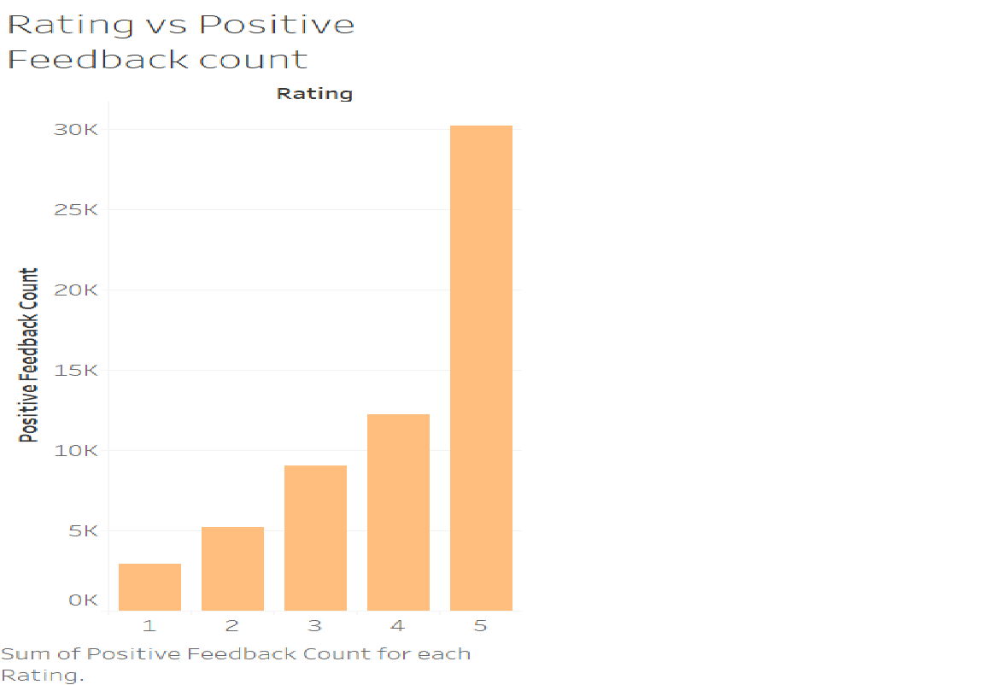
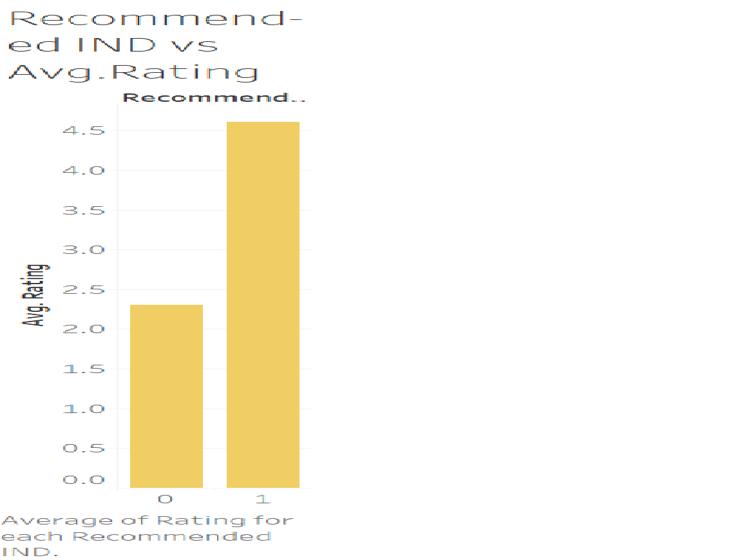

Slide 13
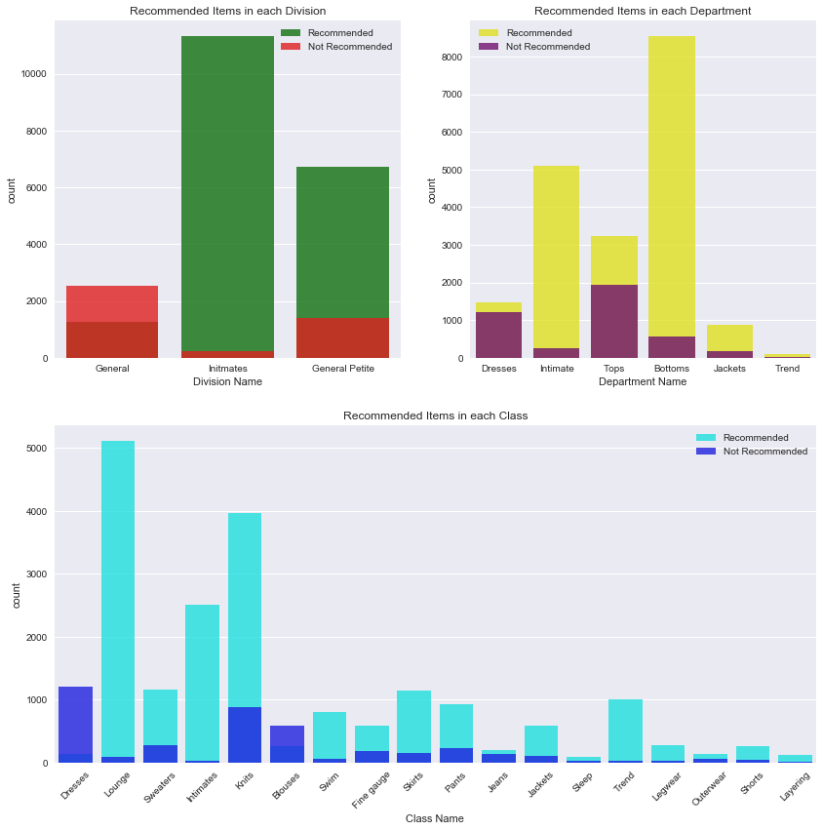

Slide 14
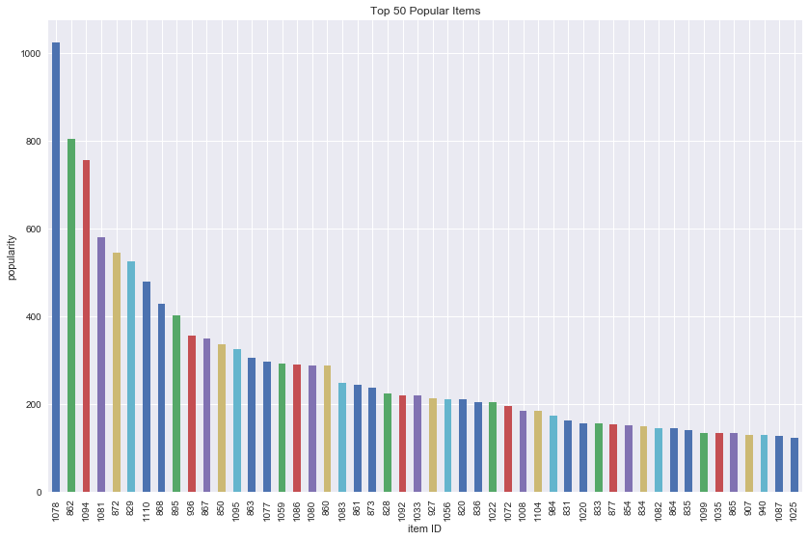

Slide 15
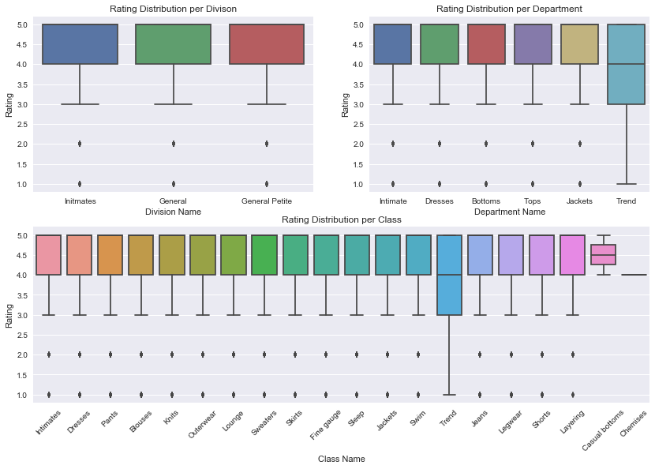

Slide 16
Model Building
Feature
Selection
Training
(2/3)
Testing
(1/3)
Model Deployment
Model Building
& Evaluation

Slide 17
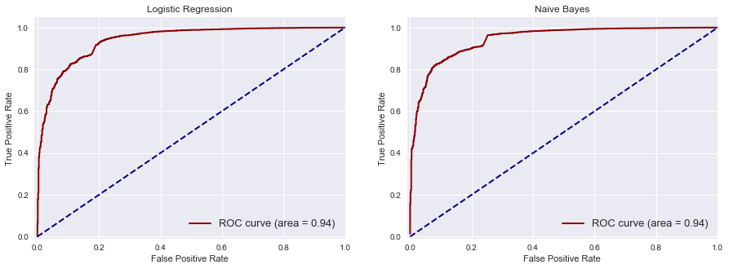
Model Comparison

Slide 18
Recommendation
High priority to reviews of Women between 25 and 50
Improve recommended items in Initmates and General petite under Division
Improve recommended items in Dresses under Department
Recommended items should exceeds the actual expectation of customer
Deploy Logistic regression model for Prediction

